Slide 1
Database Processing: Fundamentals, Design, and Implementation
Chapter 3
The Relational Model and Normalization

Slide 2
Learning Objectives
3.1 To understand basic relational terminology
3.2 To understand the characteristics of relations
3.3 To understand alternative terminology used in describing the relational model
3.4 To be able to identify functional dependencies, determinants, and the dependent attributes
3.5 To identify primary, candidate, and composite keys
3.6 To be able to identify possible insertion, deletion, and update anomalies in a relation
3.7 To be able to place a relation into BCNF normal form
3.8 To understand the special importance of domain key normal form
3.9 To be able to identify multivalued dependencies
3.10 To be able to place a relation in fourth normal form

Slide 3
Chapter Premise
We have received one or more tables of existing data.
The data is to be stored in a new database.
QUESTION: Should the data be stored as received, or should it be transformed for storage?

Slide 4
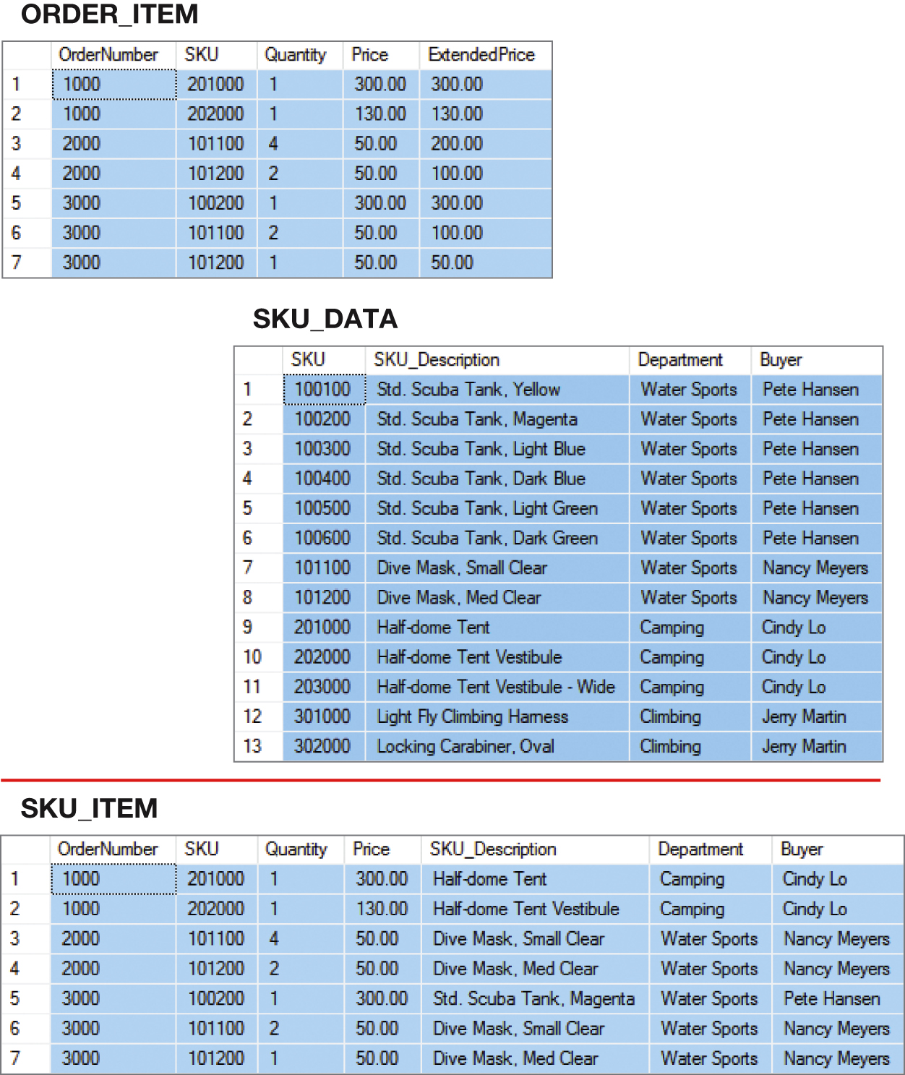
Figure 3-1 How Many Tables?

Slide 5

Figure 3-2 A Very Strange Table!
To understand why this is a very odd table, suppose that Nancy Meyers is assigned a new, SKU 101300! What addition should we make to this table? One or two rows?

Slide 6
But First--
We need to understand:
The relational model
Relational model terminology

Slide 7
The Relational Model
Introduced in a paper published in 1970
Created by E.F. Codd
IBM engineer
The model used mathematics known as “relational algebra”
Now the standard model for commercial DBMS products

Slide 8
Figure 3-3 Important Relational Model Terms
Important Relational Terms
Relation
Functional Dependency
Determinant
Candidate Key
Composite Key
Primary Key
Surrogate Key
Foreign Key
Referential integrity constraint
Normal forms
Multivalued dependency

Slide 9
Entity
An entity is some identifiable thing that users want to track:
Customers
Computers
Sales

Slide 10
Figure 3-4 Relation
Relational DBMS products store data about entities in relations, which are a special type of table.
A relation is a two-dimensional table that has the following characteristics:
Characteristics of Relations
Rows contain data about an entity.
Columns contain data about attributes of the entities.
All entries in a column are of the same kind.
Each column has a unique name.
Cells of the table hold a single value.
The order of the columns is unimportant.
The order of the rows is unimportant.
No two rows may be identical.

Slide 11
The Domain Integrity Constraint
The requirement that all of the values in a column are of the same kind is known as the domain integrity constraint.
The term domain means a grouping of data that meets a specific type definition.
FirstName could have a domain of names such as Albert, Bruce, Cathy, David, Edith, and so forth.
All values of FirstName must come from the names in that domain.
Columns in different relations may have the same name.

Slide 12
Figure 3-5 A Sample EMPLOYEE Relation
EmployeeNumber | FirstName | LastName | Department | EmailAddress | Phone
100 | Jerry | Johnson | Accounting | JJ@somewhere.com | 518-834-1101
200 | Mary | Abernathy | Finance | MA@somewhere.com | 518-834-2101
300 | Liz | Smathers | Finance | LS@somewhere.com | 518-834-2102
400 | Tom | Caruthers | Accounting | TC@somewhere.com | 518-834-1102
500 | Tom | Jackson | Production | TJ@somewhere.com | 518-834-4101
600 | Eleanore | Caldera | Legal | EC@somewhere.com | 518-834-3101
700 | Richard | Bandalone | Legal | RB@somewhere.com | 518-834-3102

Slide 13
Figure 3-6 Tables That are Not Relations: Multiple Entries per Cell
EmployeeNumber | FirstName | LastName | Department | EmailAddress | Phone
100 | Jerry | Johnson | Accounting | JJ@somewhere.com | 518-834-1101
200 | Mary | Abernathy | Finance | MA@somewhere.com | 518-834-2101
300 | Liz | Smathers | Finance | LS@somewhere.com | 518-834-2102
400 | Tom | Caruthers | Accounting | TC@somewhere.com Fax: Home: | 518-834-2102 518-834-9911 518-723-8795
500 | Tom | Jackson | Production | TJ@somewhere.com | 518-834-4101
600 | Eleanore | Caldera | Legal | EC@somewhere.com Fax: Home: | 518-834-3101 518-834-9912 518-723-7654
700 | Richard | Bandalone | Legal | RB@somewhere.com | 518-834-3102

Slide 14
Figure 3-7 Tables That Are Not Relations Table with Required Row Order
EmployeeNumber | FirstName | LastName | Department | EmailAddress | Phone
100 | Jerry | Johnson | Accounting | JJ@somewhere.com | 518-834-1101
200 | Mary | Abernathy | Finance | MA@somewhere.com | 518-834-2101
300 | Liz | Smathers | Finance | LS@somewhere.com | 518-834-2102
400 | Tom | Caruthers | Accounting | TC@somewhere.com | 518-834-2102
 |  |  |  | Fax: | 518-834-9911
 |  |  |  | Home: | 518-723-8795
500 | Tom | Jackson | Production | TJ@somewhere.com | 518-834-4101
600 | Eleanore | Caldera | Legal | EC@somewhere.com | 518-834-3101
 |  |  |  | Fax: | 518-834-9912
 |  |  |  | Home: | 518-723-7654
700 | Richard | Bandalone | Legal | RB@somewhere.com | 518-834-3102

Slide 15
Figure 3-8 A Relation with Values of Varying Length
EmployeeNumber | FirstName | LastName | Department | EmailAddress | Phone | Comment
100 | Jerry | Johnson | Accounting | JJ@somewhere.com | 518-834-1101 | Joined the Accounting Department in March after completing his MBA. Will take the CPA exam this fall.
200 | Mary | Abernathy | Finance | MA@somewhere.com | 518-834-2101
300 | Liz | Smathers | Finance | LS@somewhere.com | 518-834-2102
400 | Tom | Caruthers | Accounting | TC@somewhere.com | 518-834-1102
500 | Tom | Jackson | Production | TJ@somewhere.com | 518-834-4101
600 | Eleanore | Caldera | Legal | EC@somewhere.com | 518-834-3101
700 | Richard | Bandalone | Legal | RB@somewhere.com | 518-834-3102 | Is a full-time consultant to Legal on a retainer basis.

Slide 16
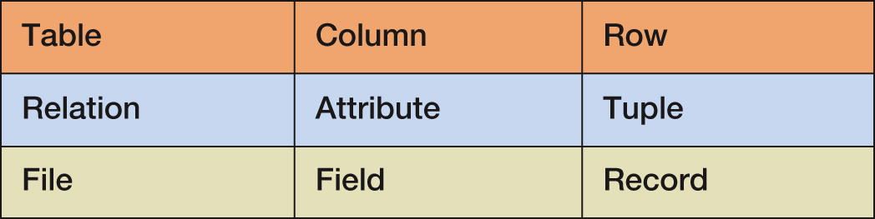
Figure 3-9 Alternative Terminology
The terms table and relation are normally used interchangeably.
The following sets of terms are equivalent:

Slide 17
To Key, or Not to Key That is the Question!
In a relation as defined by Codd:
The rows of a relation must be unique.
These is no requirement for a designated primary key.
The requirement for unique rows implies that a primary key can be designated.
In the “real world,” every relation has a primary key.
When do we designate a primary key?
We need some more information!

Slide 18
Functional Dependencies
A functional dependency occurs when the value of one (set of) attribute(s) determines the value of a second (set of) attribute(s):
CookieCost = NumberOfBoxes x $5
NumberOfBoxes → CookieCost
The attribute on the left side of the functional dependency is called the determinant.
Functional dependencies may be based on equations:
ExtendedPrice = Quantity X UnitPrice
(Quantity, UnitPrice) → ExtendedPrice
Function dependencies are not equations!

Slide 19
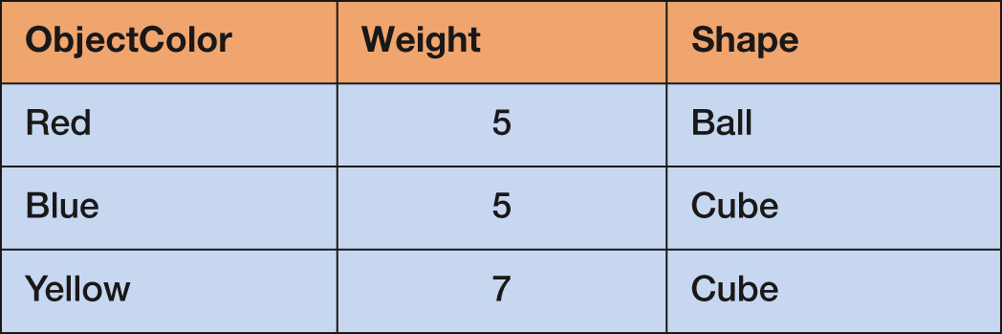
Functional Dependencies
ObjectColor → Weight
ObjectColor → Shape
ObjectColor → (Weight, Shape)

Slide 20
Composite Determinants
Composite determinant = a determinant of a functional dependency that consists of more than one attribute
(StudentNumber, ClassNumber) → (Grade)

Slide 21
Functional Dependency Rules
If A → (B, C), then A → B and A→ C.
This is the decomposition rule.
If A → B and A→ C, then A → (B, C).
This is the union rule.
However, if (A,B) → C, then neither A nor B determines C by itself.

Slide 22
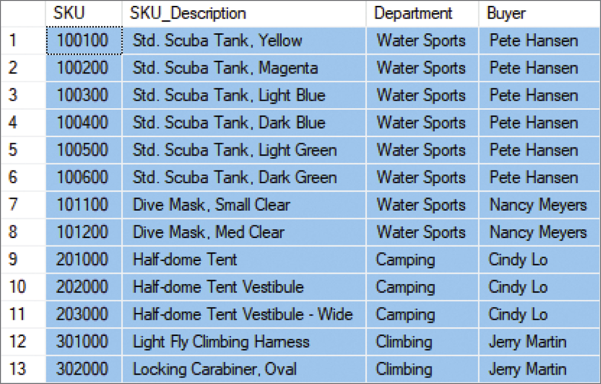
Functional Dependencies in the SKU_DATA Table (1 of 2)
Notes:
SKU -> sKU_description, department, buyer
Buyer -> department
Sku_description -> sku, buyer, department

Slide 23
Functional Dependencies in the SKU_DATA Table (2 of 2)
SKU → (SKU_Description, Department, Buyer)
SKU_Description → (SKU, Department, Buyer)
Buyer → Department

Slide 24
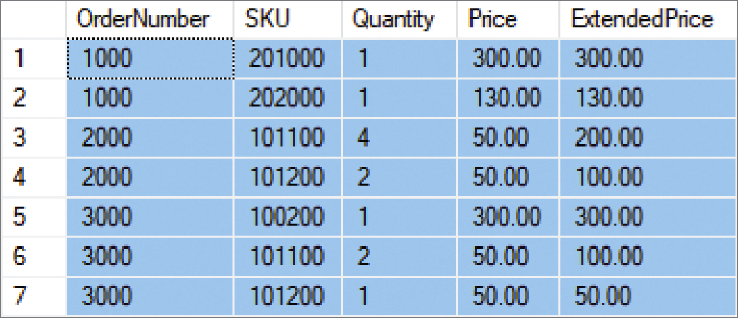
Functional Dependencies in the ORDER_ITEM Table (1 of 2)
Notes:
Ask the class the determine the functional dependencies here?

Slide 25
Functional Dependencies in the ORDER_ITEM Table (1 of 2)
(OrderNumber, SKU) →
(Quantity, Price, ExtendedPrice)
(Quantity, Price) → (ExtendedPrice)

Slide 26
What Makes Determinant Values Unique?
A determinant is unique in a relation if and only if it determines every other column in the relation.
You cannot find the determinants of all functional dependencies simply by looking for unique values in one column:
Must be logically a determinant

Slide 27
Keys
A key is a combination of one or more columns that is used to identify particular rows in a relation.
A composite key is a key that consists of two or more columns.

Slide 28
Candidate and Primary Keys
A candidate key is a key with no repeated values.
A table can have multiple candidate key
It uniquely identifies each record in a table
A primary key is a candidate key selected as the primary means of identifying rows in a relation.
There is only one primary key per relation.
The primary key may be a single key or a composite key.

Slide 29
Why we need a key
Keys help identify any row of data in a table. In a real world application, a table could contain thousands of records. Moreover the records could be duplicated. Keys ensure that you can uniquely identify a table record despite these challenges.
Allows you to establish a relationship between and identify the relation between tables.
Helps to enforce identity and integrity in the relationship.

Slide 30
The Entity Integrity Constraint
The requirement that, in order to function properly, the primary key must have unique data values inserted into every row of the table. This is known as the entity integrity constraint.
The phrase unique data values implies that this column is NOT NULL, and does not allow a NULL value in any row.

Slide 31
Surrogate Keys (1 of 2)
A surrogate key is an artificial column added to a relation to serve as a primary key.
DBMS supplied
Short, numeric, and never changes—an ideal primary key
Has artificial values that are meaningless to users
Normally hidden in forms and reports

Slide 32
Foreign Keys (1 of 2)
A foreign key is a column or composite of columns that is the primary key of a table other than the one in which it appears. The term arises because it is a key of a table foreign to the one in which it appears as the primary key.

Slide 33
Foreign Keys (2 of 2)
NOTE: The primary keys of the relations are underlined and any foreign keys are in italics in the relations below:
DEPARTMENT (DepartmentName, BudgetCode, ManagerName)
EMPLOYEE (EmployeeNumber, EmployeeLastName,
EmployeeFirstName, DepartmentName)

Slide 34
The Referential Integrity Constraint
A referential integrity constraint is a statement that limits the values of the foreign key to those already existing as primary key values in the corresponding relation:
SKU in ORDER_ITEM must exist in SKU in SKU_DATA

Slide 35
Foreign Key with a Referential Integrity Constraint
NOTE: The primary key of the relation is underlined and any foreign keys are in italics in the relations below:
SKU_DATA (SKU, SKU_Description, Department, Buyer)
ORDER_ITEM (OrderNumber, SKU, Quantity, Price, ExtendedPrice)
Where ORDER_ITEM.SKU must exist in SKU_DATA.SKU

Slide 36
Database Integrity
We have defined three constraints so far in our discussion:
The domain integrity constraint
The entity integrity constraint
The referential integrity constraint
The purpose of these three constraints, taken as a whole, is to create database integrity, which means that the data in our database will be useful, meaningful data.

Slide 37
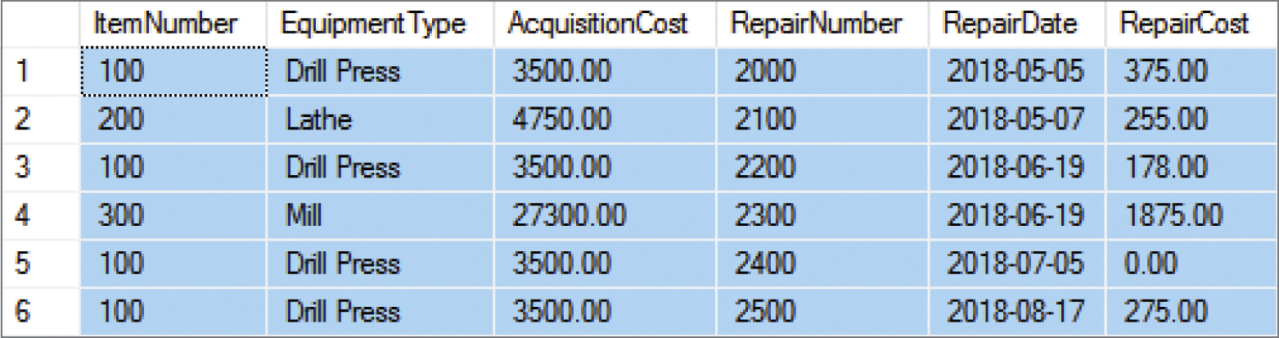
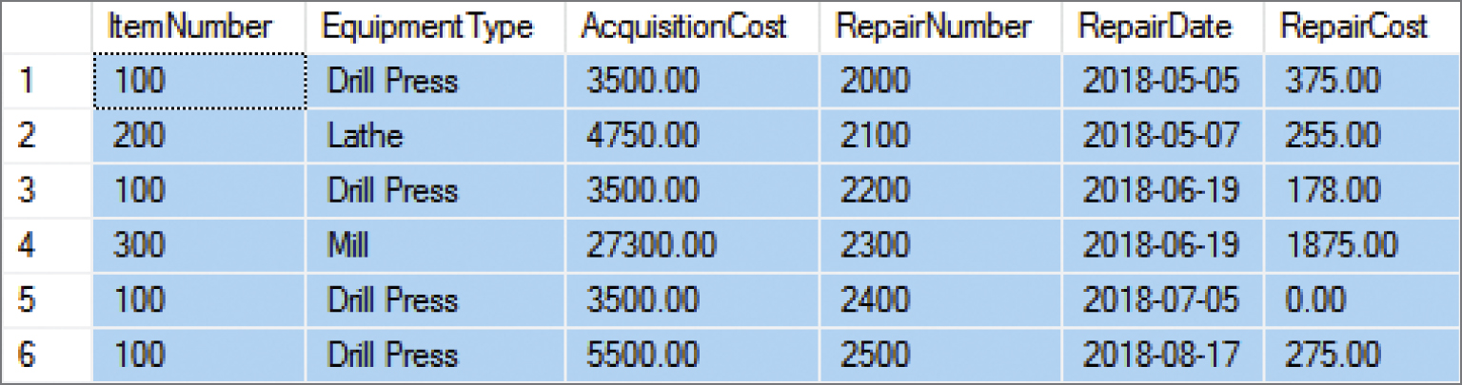
Figures 3-10 & 3-11 Modification Anomalies
The EQUIPMENT_REPAIR table before and after an incorrect update operation on AcquisitionCost for EquipmentType = Drill Press:

Slide 38
Types of Modification Anomalies
Deletion anomaly
Insertion anomaly
Update anomaly
Notice that the EQUIPMENT_REPAIR table duplicates data. For example, the AcquisitionCost of the same item of equipment appears several times. Any table that duplicates data is susceptible to update anomalies. A table that has such inconsistencies is said to have data integrity problems.

Slide 39
Figure 3-12 Summary of Normalization Theory
Relations are categorized as a normal form based on which modification anomalies or other problems they are subject to:
Sources of Anomaly | Normal Forms | Design Principles
Functional Dependencies | 1NF, 2NF 3NF, BCNF | BCNF: Design tables so that every determinant is a candidate key
Multivalued dependencies | 4NF | 4NF: Move each multivalued dependency to a table of its own
Data constraints and oddities | 5NF, DK/NF | DK/NF: Make every constraint a logical consequence of candidate keys and domains

Slide 40
First Normal Form (1NF)
Remember that question - To Key or Not to Key?
Codd’s set of conditions for a relation does not require a primary key, but one is clearly implied by the condition that all rows must be unique. Thus, we will define 1NF as:
Meets the set of conditions for a relation
Has a defined primary key
A review of Figure 3-4 lists the characteristics of a relation.

Slide 41
Second Normal Form (2NF)
A relation is in 2NF if, and only if, it is in 1NF and all non-key attributes are determined by the entire primary key. This is also known as a Partial Dependency.
For example:
A relation R(A, B, N, O, P) with the composite key (A,B) means that none of the non-key attributes N, O, or P can be determined by just A or just B.
(StudentID, Activity) → ActivityFee
Activity →x ActivityFee

Slide 42
Third Normal Form (3NF)
A relation is in 3NF if, and only if, it is in 2NF and there are no non-key attributes determined by another non-key attribute. This is also known as a Transitive Dependency.
For example:
A relation R(A, B, N, O, P) with the composite key (A,B) means that none of the non-key attributes N, O, or P can be determined by N, O, or P.
STUDENT_HOUSING (StudentID, Building, BuildingFee)
Building →x BuildingFee

Slide 43
Boyce-Codd Normal Form (BCNF)
A relation is in BCNF if, and only if, it is in 3NF and every determinant is a candidate key.

Slide 44
Figure 3-19 Eliminating Anomalies from Functional Dependencies with BCNF
Process for Putting a Relation into BCNF
1. Identify every functional dependency.
2. Identify every candidate key.
3. If there is a functional dependency that has a determinate that is not a candidate key:
A. Move the column of that functional dependency into a new relation. B. Make the determinant of that functional dependency the primary key of the new relation. C. Leave a copy of the determinant as a foreign key in the original relation. D. Create a referential integrity constraint between the original relation and the new relation.
4. Repeat step 3 until every determinant of every relation is a candidate key.
Note: In step 3, if there is more than one such functional dependency, start with the one with the most columns.

Slide 45
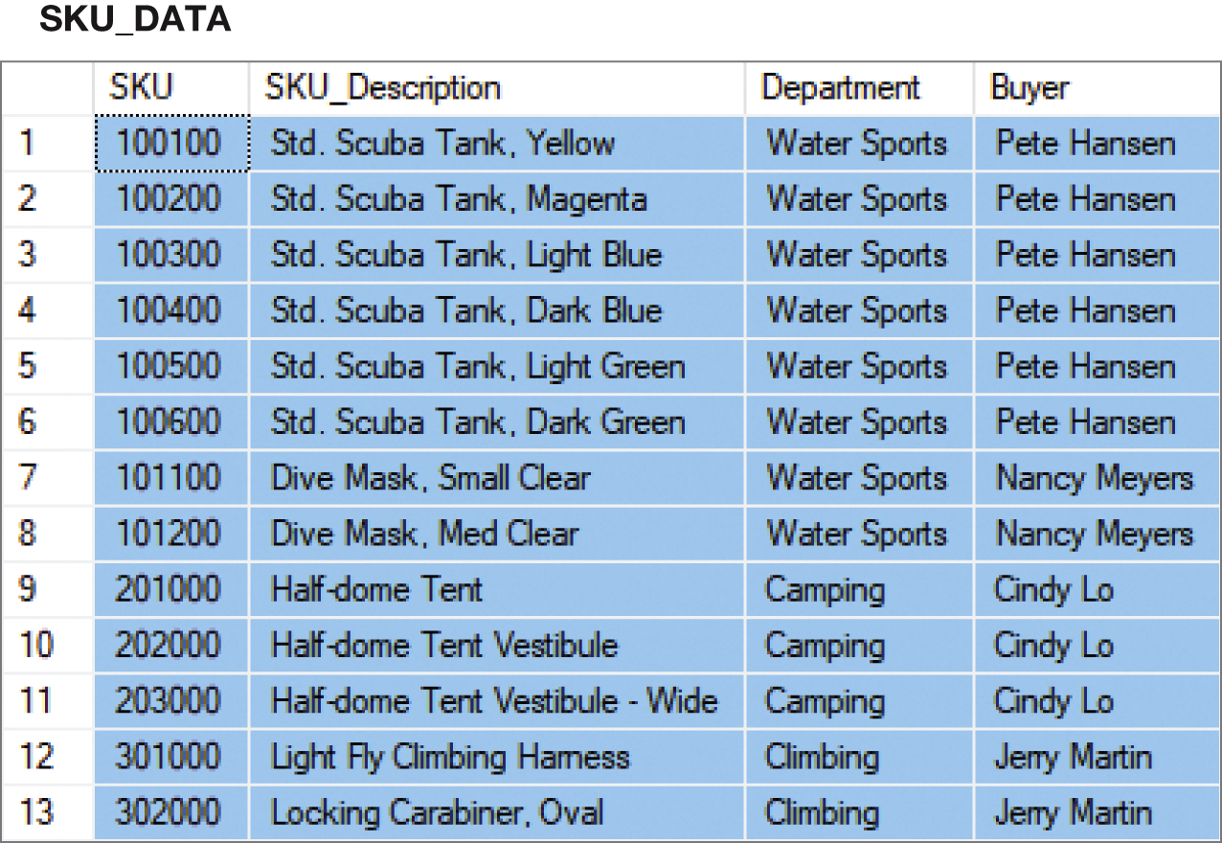
Figure 3-20 Putting the SKU_DATA Table into BCNF (Step-by-Step) - 1NF
SKU_DATA (SKU, SKU_Description, Department, Buyer)
1NF – Checking against 1NF, this relation is in 1NF.
Notes:
1NF ..see that we have a primary key which is the 1nf rule

Slide 46
Putting the SKU_DATA Table into BCNF (Step-by-Step) - 2NF
SKU_DATA (SKU, SKU_Description, Department, Buyer)
SKU → (SKU_Description, Department, Buyer)
SKU_Description → (SKU, Department, Buyer)
Buyer → Department
SKU and SKU_Description are candidate keys.
A relation is in 2NF if, and only if, it is in 1NF and all non-key attributes are determined by the primary key.
Since SKU is a single column primary key, all non-key attributes are determined by SKU, and the relation is in 2NF.

Slide 47
Putting the SKU_DATA Table into BCNF (Step-by-Step) - 3NF (1 of 2)
SKU_DATA (SKU, SKU_Description, Department, Buyer)
SKU → (SKU_Description, Department, Buyer)
SKU_Description → (SKU, Department, Buyer)
Buyer → Department
SKU and SKU_Description are candidate keys.
A relation is in 3NF if, and only if, it is in 2NF and there are no non-key attributes determined by another non-key attribute.
However, the term non-key attribute means an attribute that is neither (1) a candidate key itself, nor (2) part of a composite candidate key.
Therefore, the only non key attribute is Buyer, and it is a determinant of Department.
Therefore, this is not in 3NF.

Slide 48
Putting the SKU_DATA Table into BCNF (Step-by-Step) - 3NF (2 of 2)
Therefore, break out the Buyer → Department functional dependency.
SKU_DATA_2 (SKU, SKU_Description, Buyer)
BUYER (Buyer, Department)
Where SKU_DATA_2.Buyer must exist in BUYER.Buyer
SKU_DATA_2 is in 3NF
BUYER is in 3NF

Slide 49
Putting the SKU_DATA Table into BCNF (Step-by-Step) - BCNF
SKU_DATA_2 (SKU, SKU_Description, Buyer)
BUYER (Buyer, Department)
Where SKU_DATA_2.Buyer must exist in BUYER.Buyer
SKU → (SKU_Description, Department, Buyer)
SKU_Description → (SKU, Department, Buyer)
Buyer → Department
A relation is in BCNF if, and only if, it is in 3NF and every determinant is a candidate key.
In SKU_DATA_2, both determinants are determinant keys, so SKU_DATA_2 is in BCNF
In BUYER, the determinant is a determinate key, so BUYER is in BCNF.

Slide 50
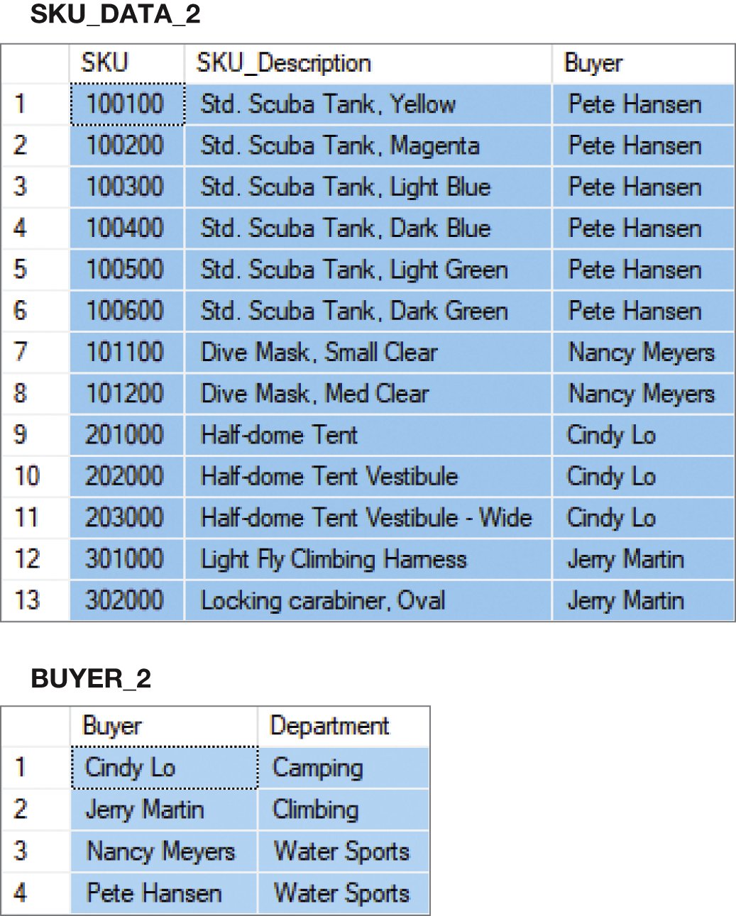
Figure 3-21 The Results of the Step-by-Step to BCNF

Slide 51
Figure 3-20 The “Straight-to-BCNF” Method

Slide 52
The “Straight-to-BCNF” Method
SKU_DATA (SKU, SKU_Description, Department, Buyer)
SKU → (SKU_Description, Department, Buyer)
SKU_Description → (SKU, Department, Buyer)
Buyer → Department
Therefore, break out the Buyer → Department functional dependency
SKU_DATA (SKU, SKU_Description, Buyer)
BUYER (Buyer, Department)
Where BUYER.Buyer must exist in SKU_DATA.Buyer

Slide 53
Figure 3-21 The Results of the Straight-to-BCNF

Slide 54
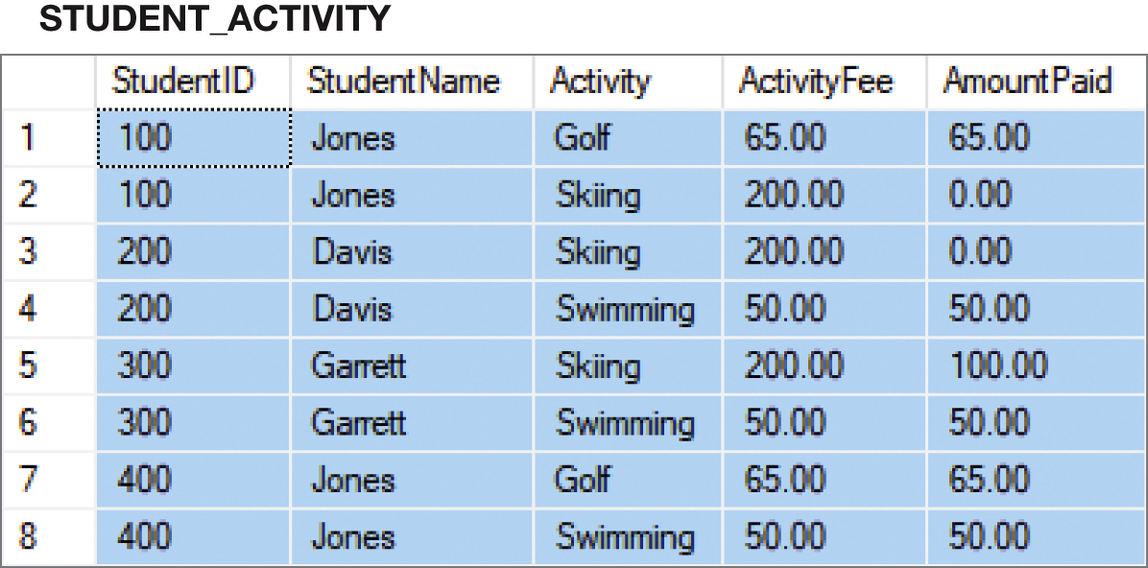
Figure 3-24 The STUDENT_ACTIVITY Normalization Example (1 of 4)

Slide 55
The STUDENT_ACTIVITY Normalization Example (2 of 4)
STUDENT_ACTIVITY (StudentID, StudentName, Activity, ActivityFee, AmountPaid)
1. Identify the functional Dependencies
StudentID → StudentName
StudentID → Activity (depends if student can or cannot belong to just one activity!)
Activity → ActivityFee
(StudentID, Activity) → ActivityFee (assume a different fee for each different activity)
(StudentID, Activity) → AmountPaid
2. Thus we have three determinants (StudentID, Activity, and (StudentID, Activity)

Slide 56
The STUDENT_ACTIVITY Normalization Example (3 of 4)
To normalize this table, we need to construct tables so that every determinant is a candidate key. We can do this by creating a separate table for each functional dependency as before.
STUDENT (StudentID, StudentName)
ACTIVITY (Activity, ActivityFee)
PAYMENT (StudentID, Activity, AmountPaid)
These tables are in BCNF and will have no anomalies from functional dependencies.

Slide 57
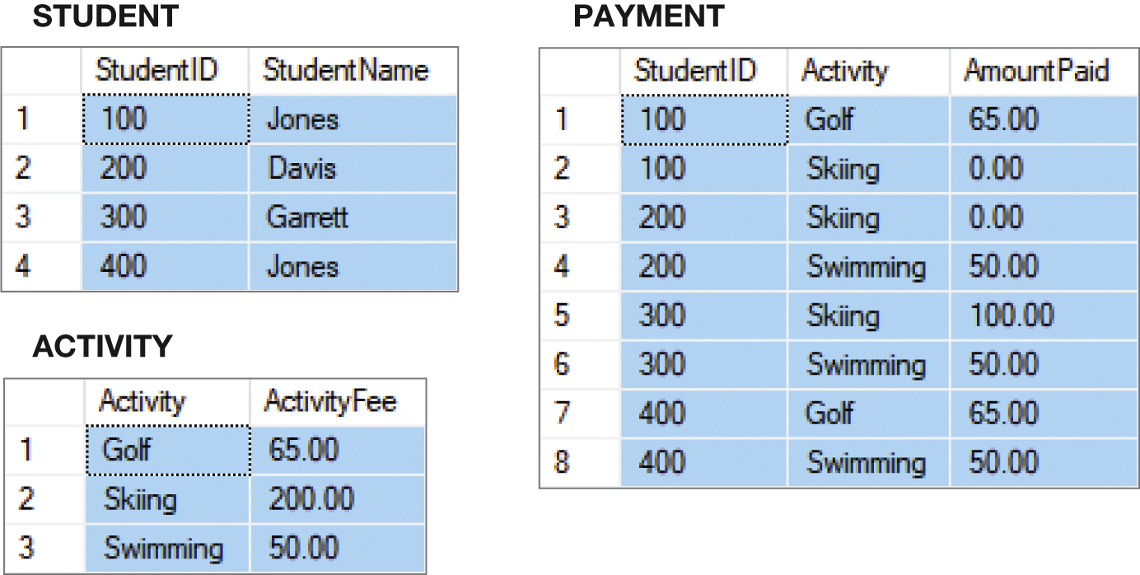
Figure 3-25 The STUDENT_ACTIVITY Normalization Example (4 of 4)

Slide 58
Multivalued Dependencies
A multivalued dependency occurs when a determinant is matched with a particular set of values:
Employee →→ Degree
Employee →→ Sibling
PartKit →→ Part
The determinant of a multivalued dependency can never be a primary key.

Slide 59
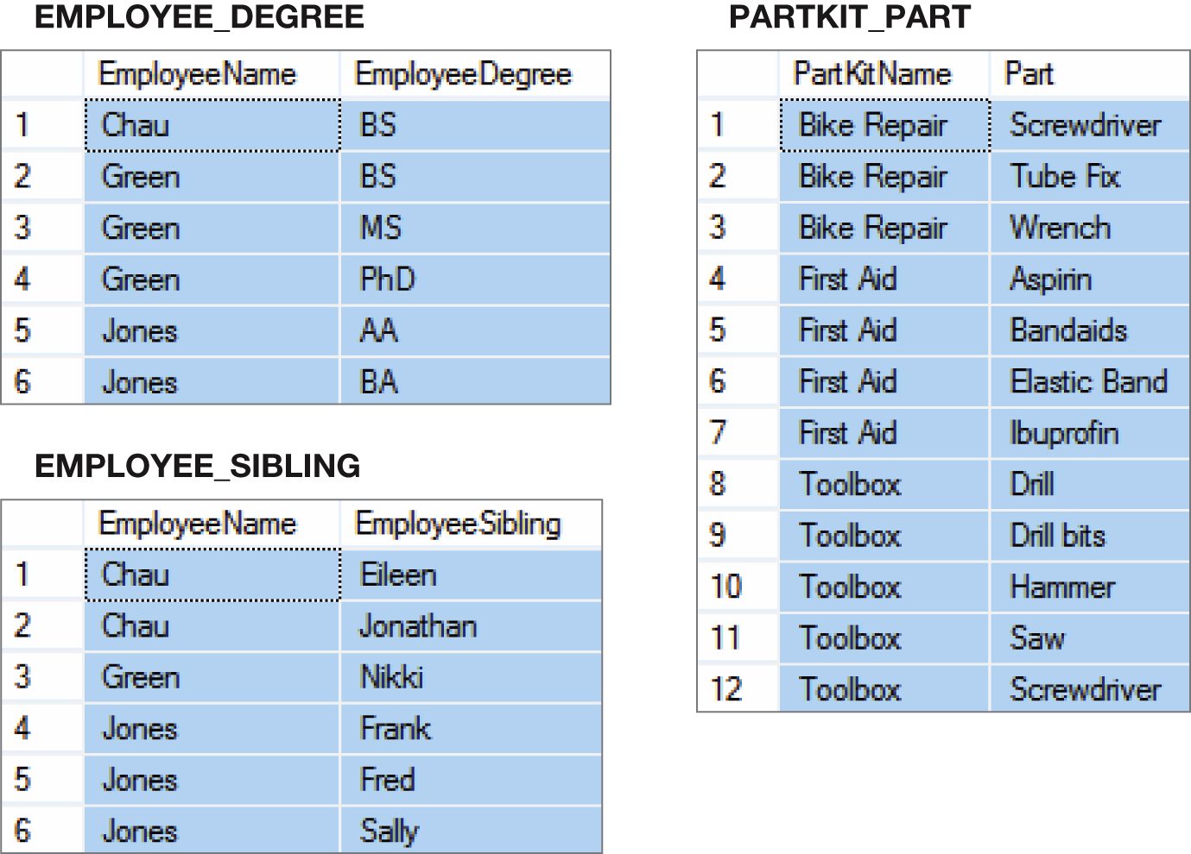
Figure 3-28 Examples of Multivalued Dependencies

Slide 60
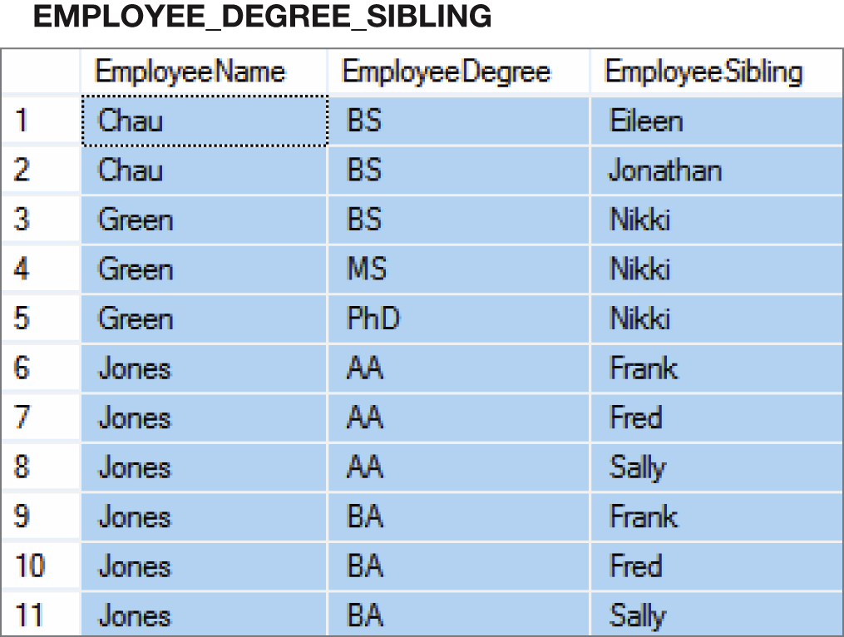
Figure 3-29 Two Multivalued Dependencies

Slide 61
Fourth Normal Form (4NF) Eliminating Multivalued Anomalies
Multivalued dependencies are not a problem if they are in a separate relation, therefore:
Always put multivalued dependencies into their own relation
This is known as Fourth Normal Form (4NF)

Slide 62
Figure 3-2 Remember That Very Strange Table?
Now we understand why this is a very strange table. It has multivalued dependencies!

Slide 63
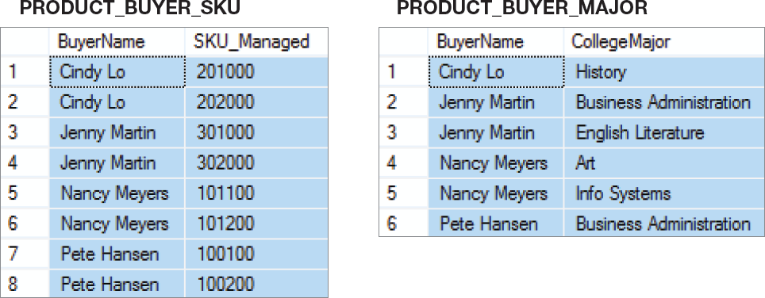
Figure 3-31 4NF
Use 4NF to resolve the multivalued dependencies!

Slide 64
Database Processing Fundamentals, Design, and Implementation (14th Edition)
End of Presentation:
Chapter Three

Slide 65

Copyright

